Slide 1
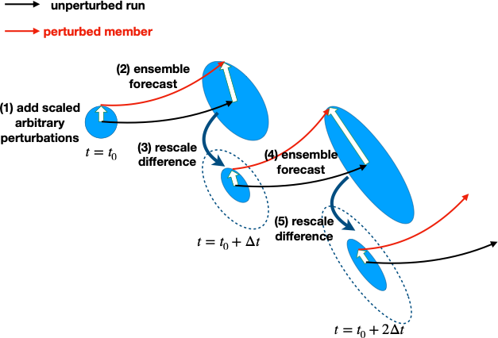
Breeding of growing modes (Toth and Kalnay 1997; Saito et al. 2011)
The BGM is used to generate 40 members in D1.
𝛥t = 6 hours
Perturb only the atmospheric part
No boundary perturbations
The rescaling factor is determined based on the dry total energy (Ehrendorfer et al. 1999).

Slide 2
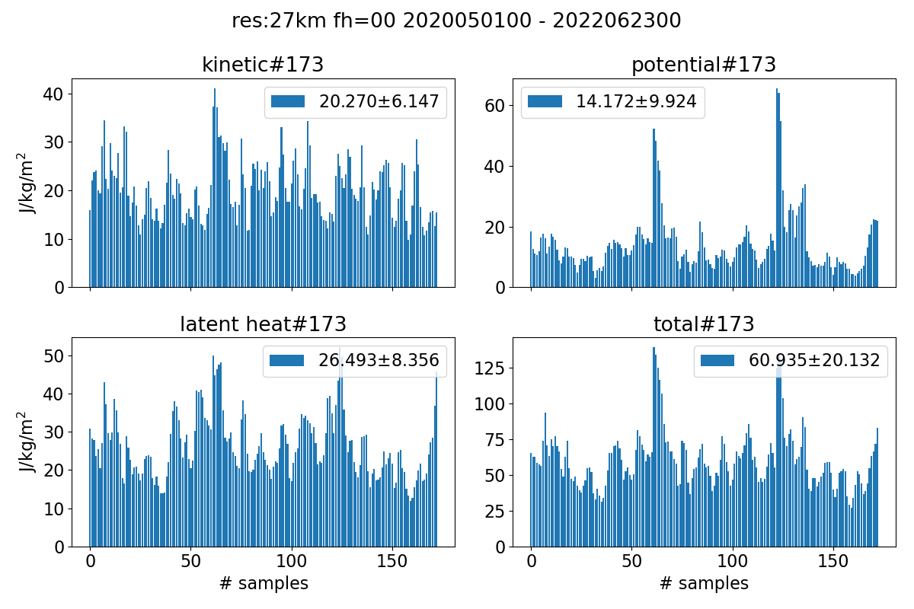
Determination of rescaling factor
Figure: Perturbation energy statistics of GFS initial states from time averaged state during May-June in 2020-2022 (173 samples). Total energy is the sum of kinetic, potential energy and latent heat. Energy is evaluated in domain 2 (110E-145E, 20N-50N). The numbers in legends indicate the mean value and 1σ standard deviation.
Based on this statistics, we set the threshold of rescaling by dry TE is 3.0 J kg⁻¹ m⁻² (around 9% of the mean of anomalous dry TE).

Slide 3
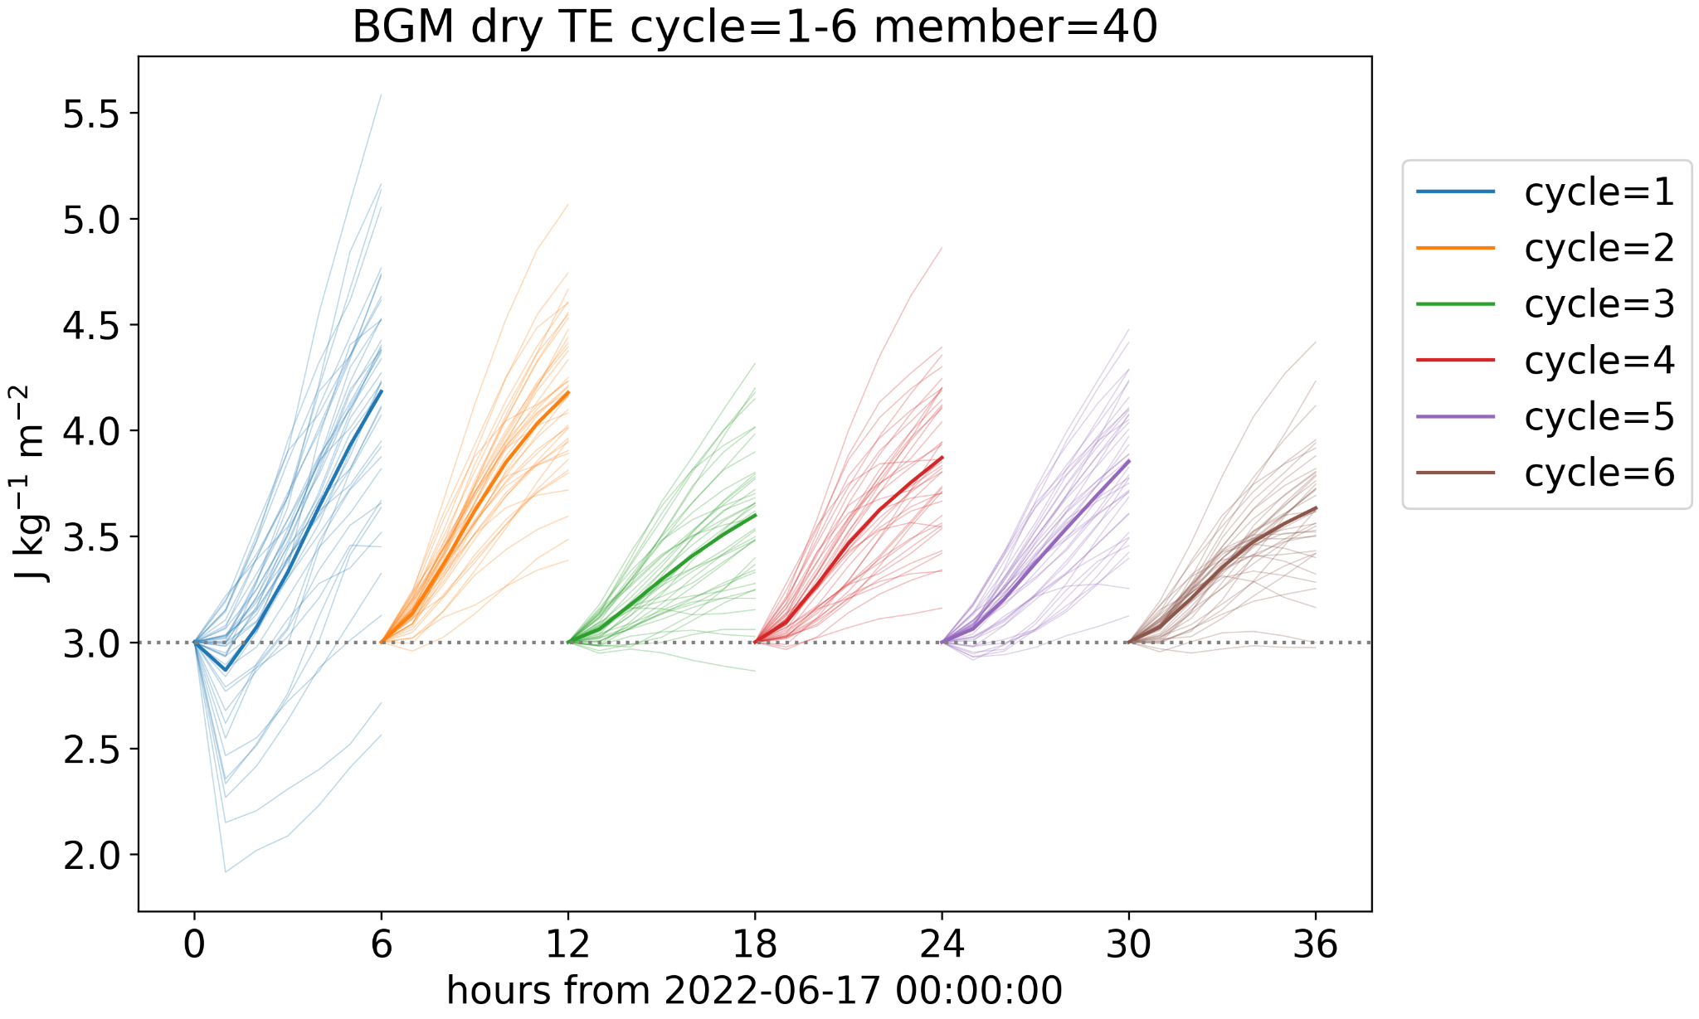
Example of dry TE evolution
Figure: Perturbation dry TE for ensemble members. Thick curves indicate the ensemble mean values.
As BGM cycles go ahead, most of the perturbations begin to grow steadily.

Slide 4
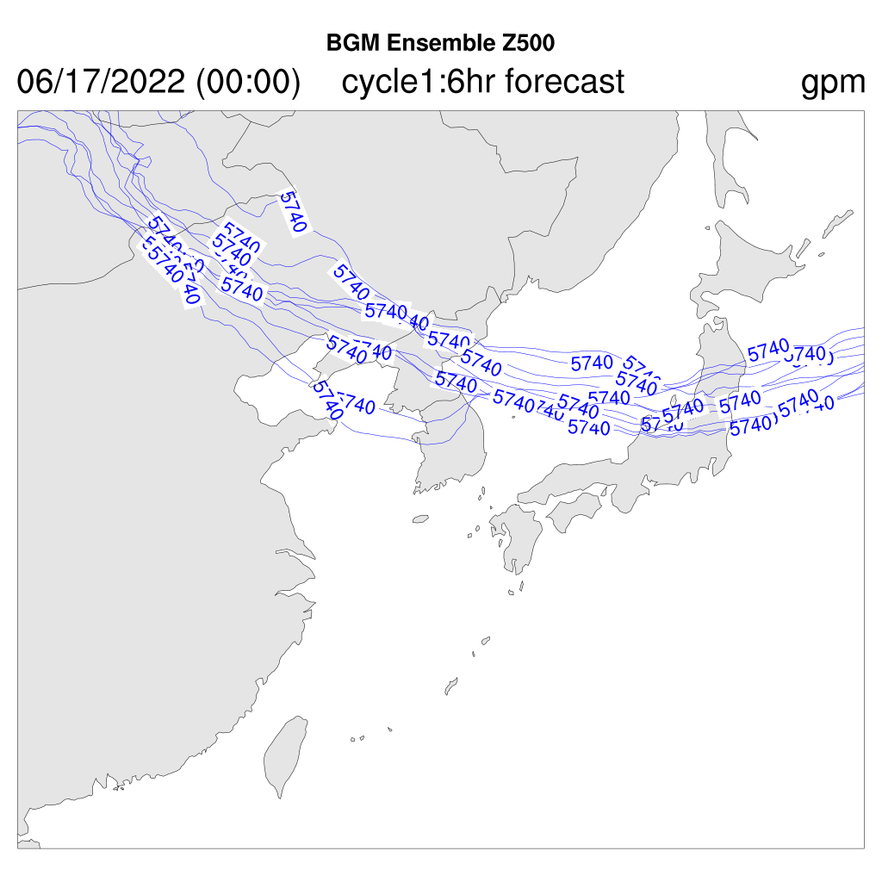
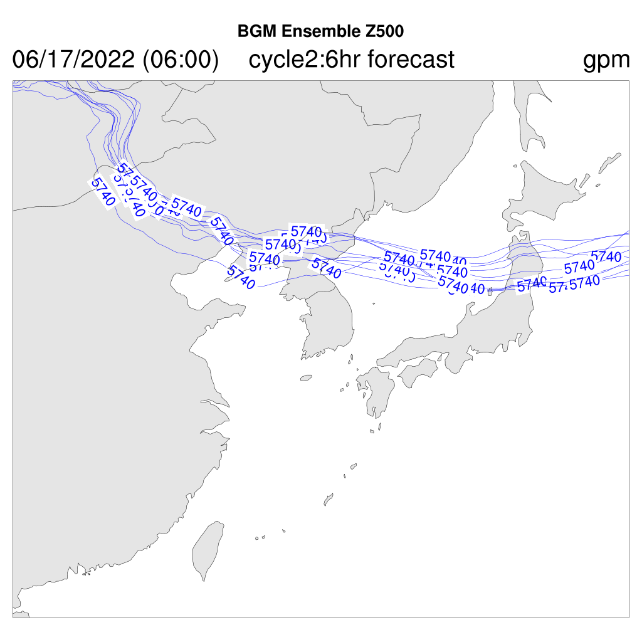
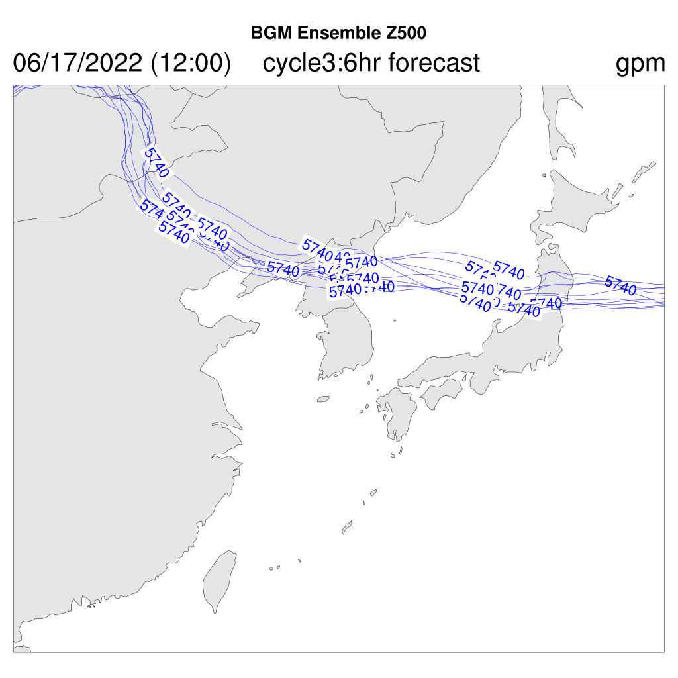
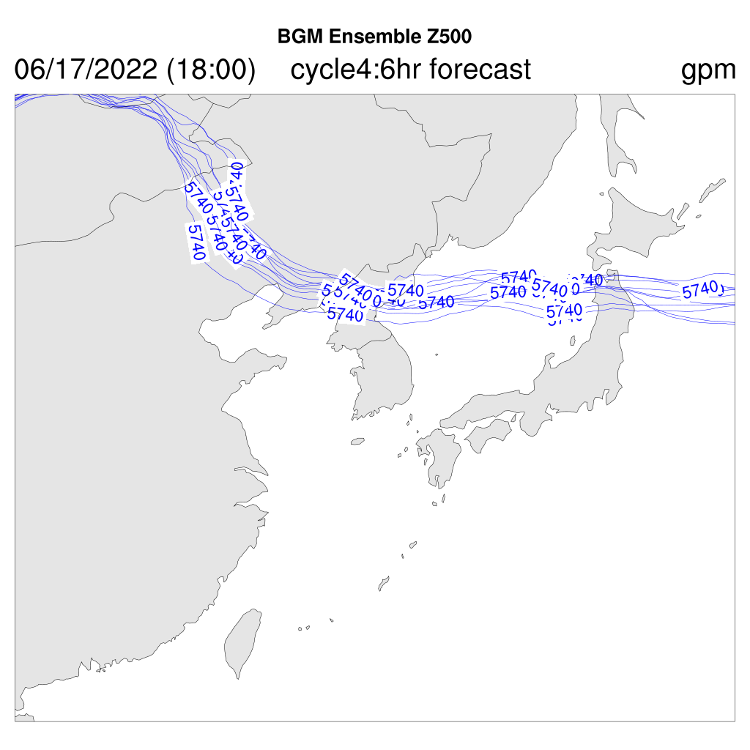
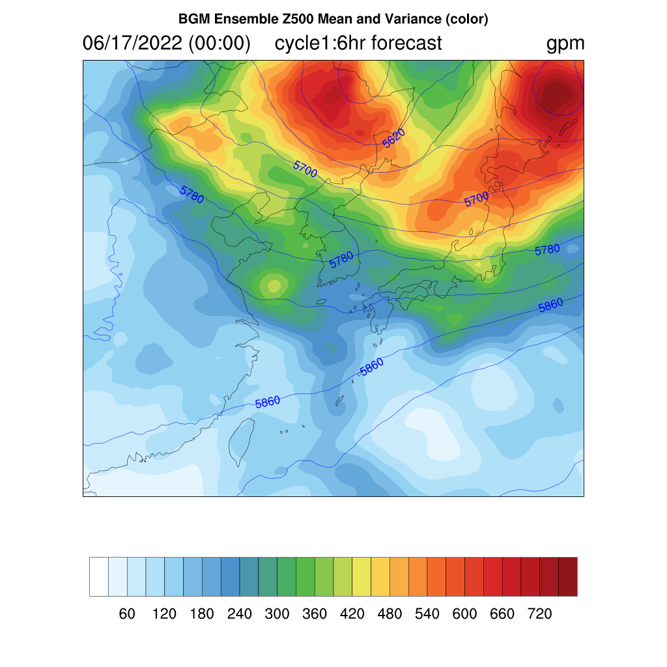
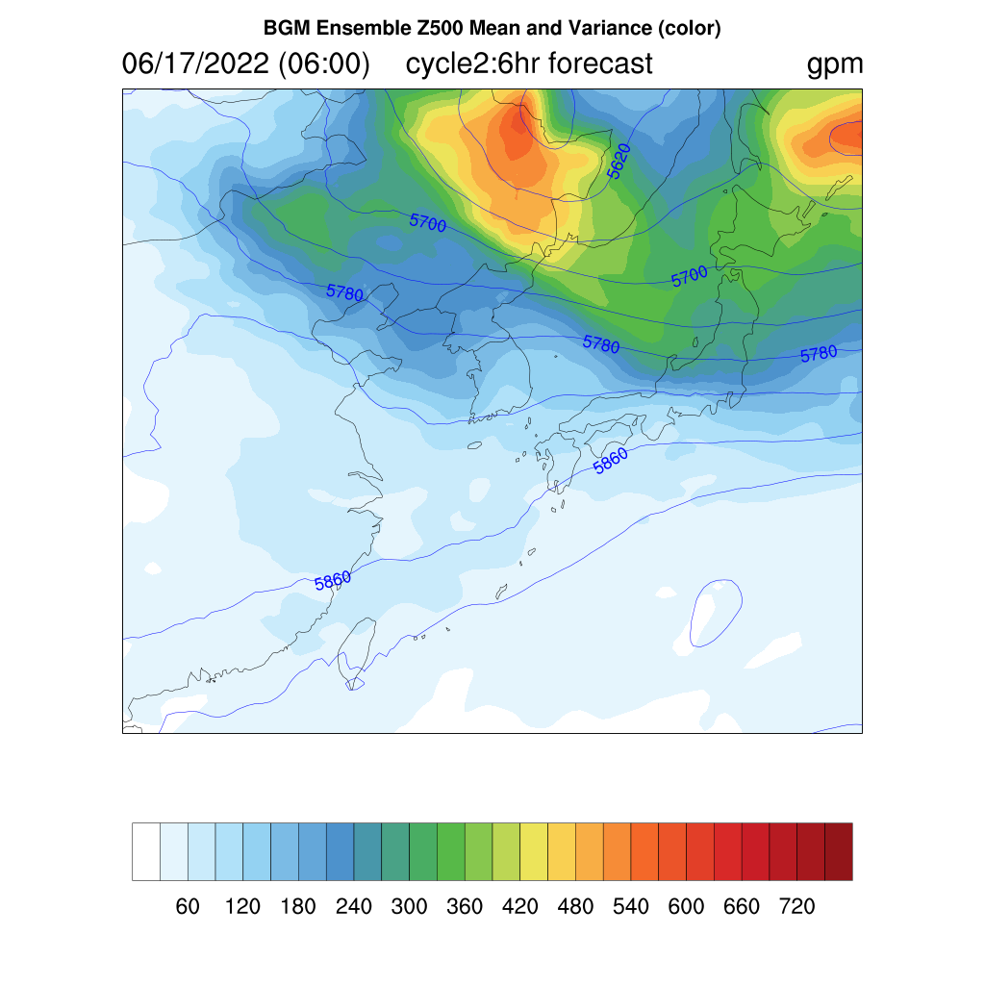
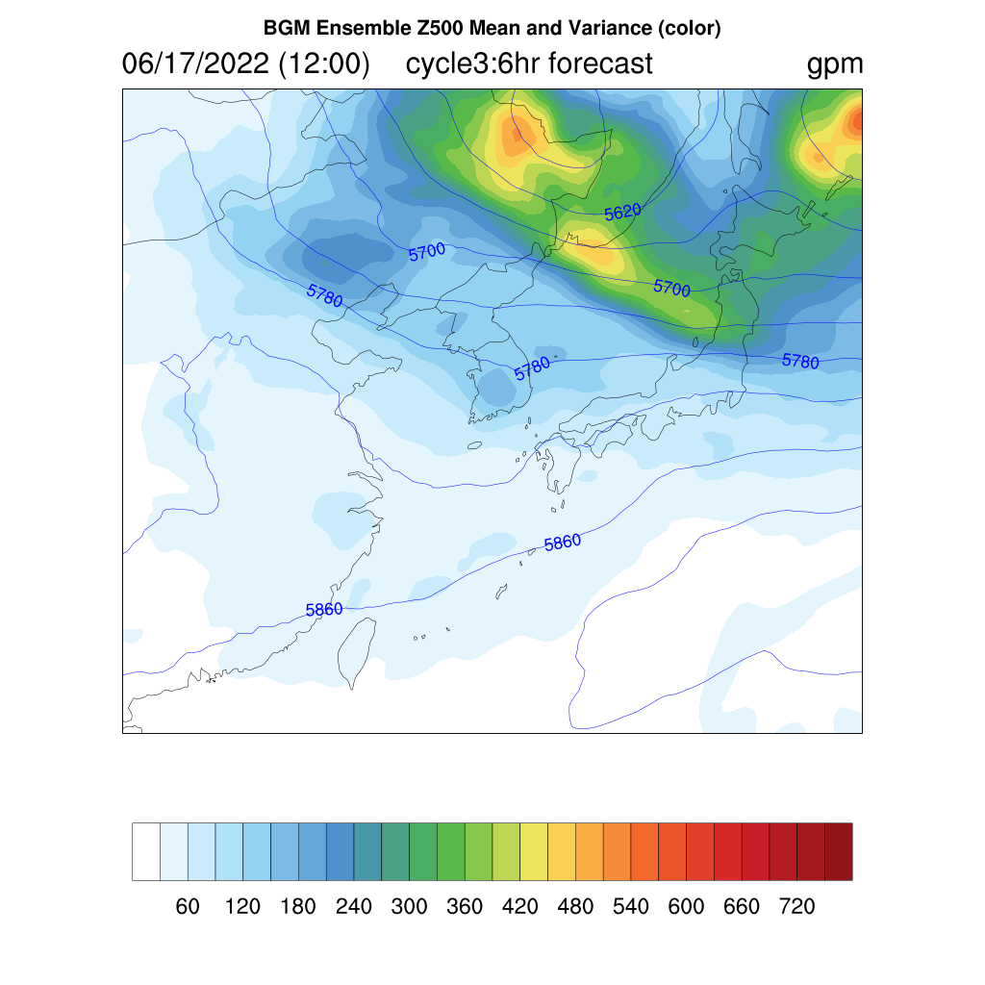
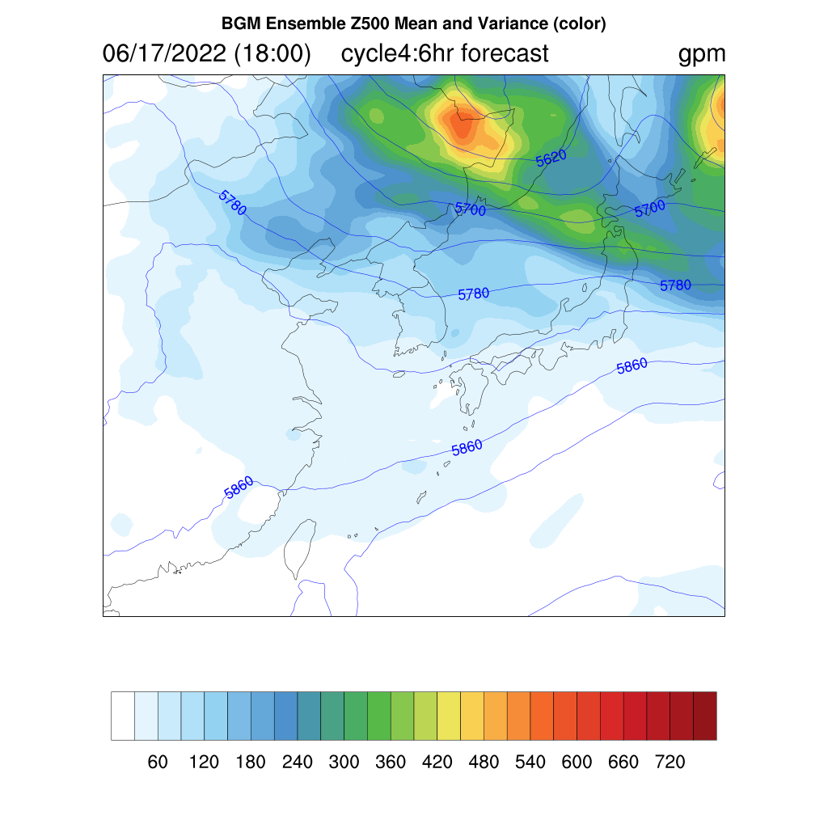
Example of Z500 variations
Notes:
Top panels: Spaghetti diagrams of 5740 gpm in 6-hour ensemble forecast
Bottom panels: 6-hour forecast ensemble mean (contour) and variance (color) of Z500

Slide 5
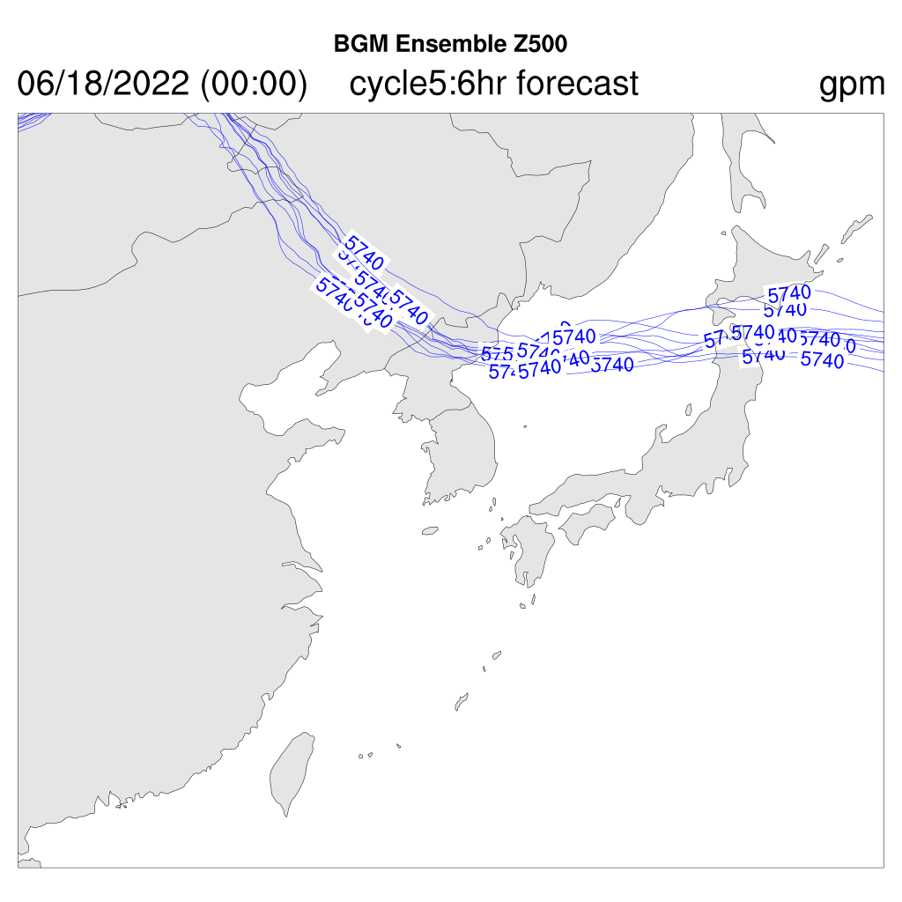
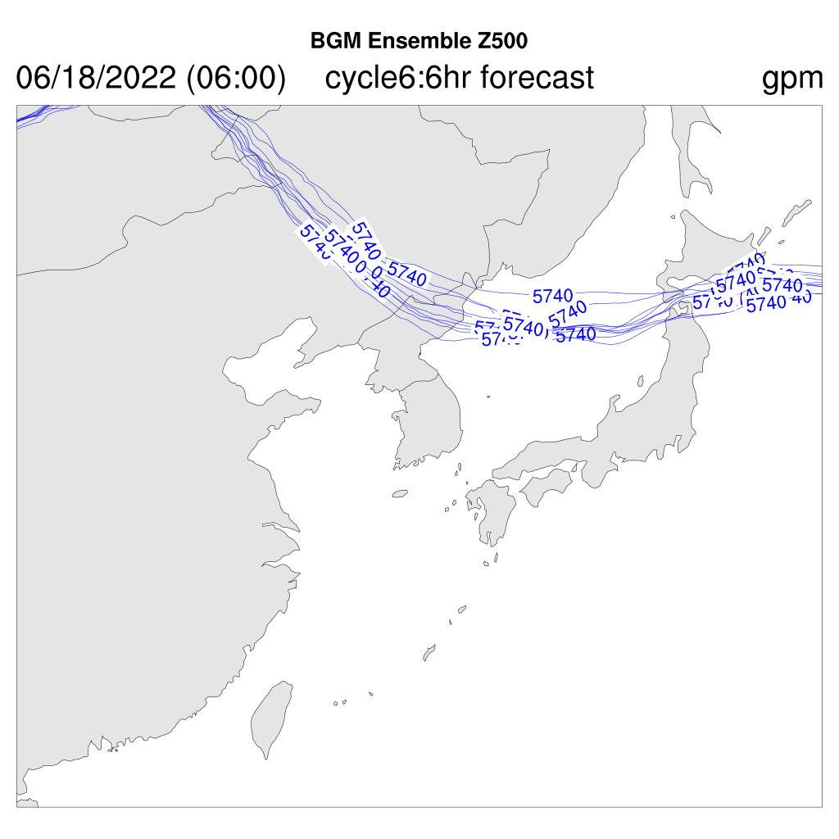
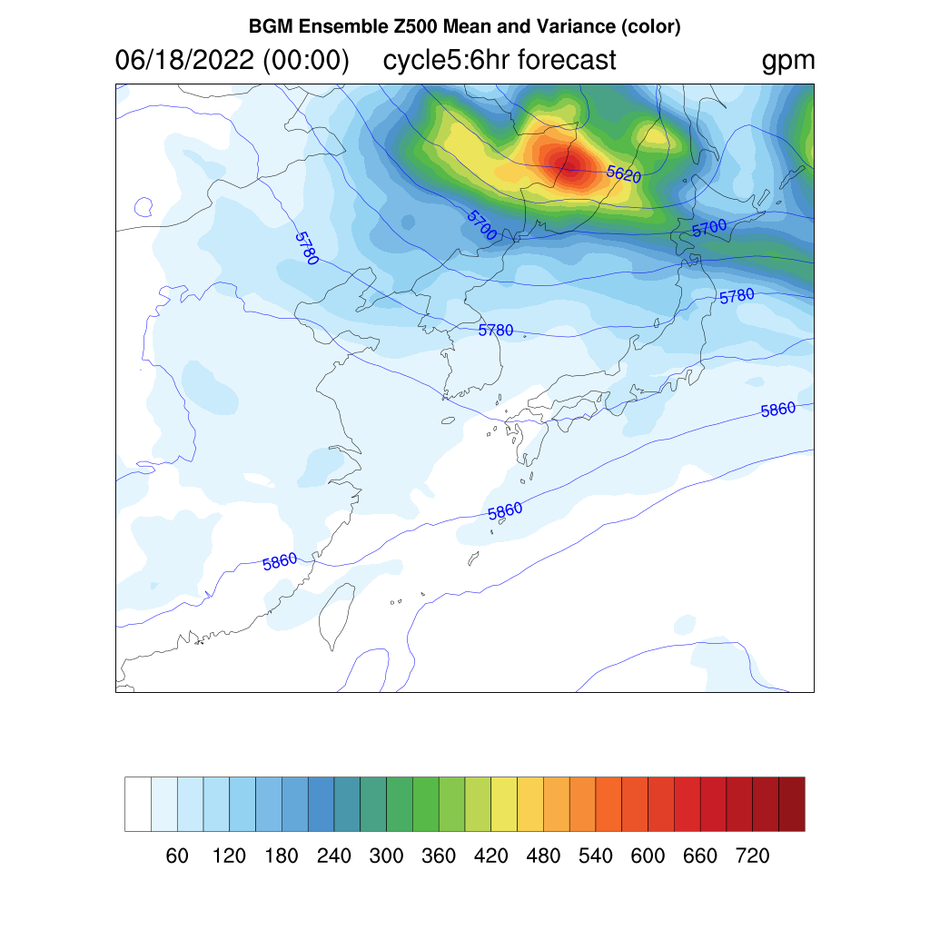
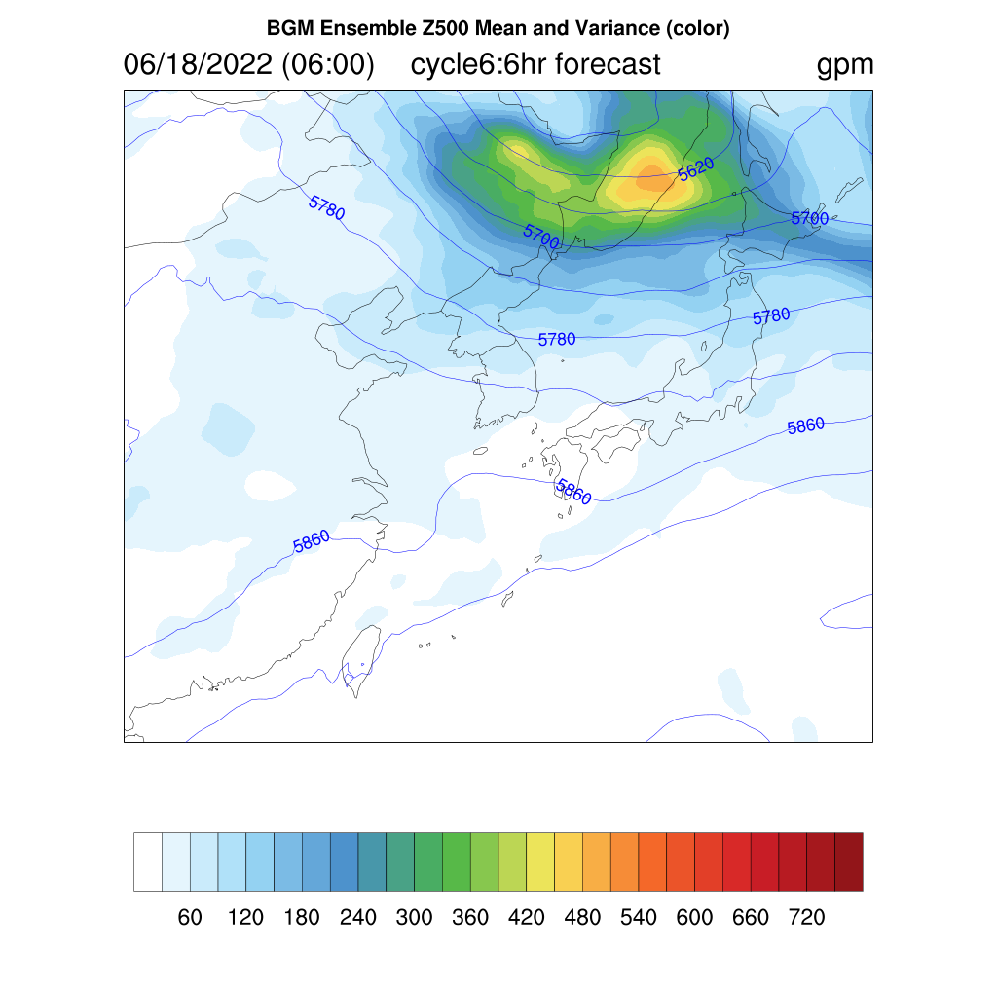
Example of Z500 variations
Notes:
Top panels: Spaghetti diagrams of 5740 gpm in 6-hour ensemble forecast
Bottom panels: 6-hour forecast ensemble mean (contour) and variance (color) of Z500

Slide 6
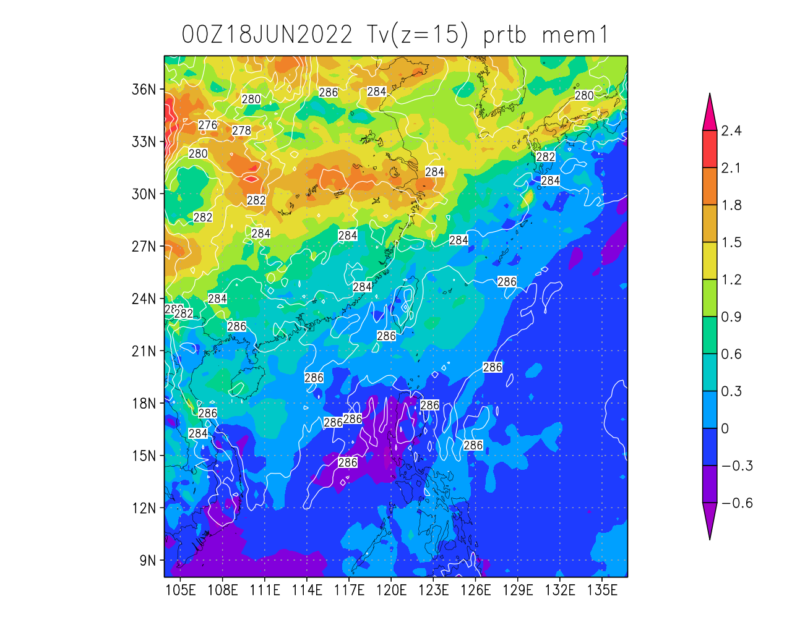
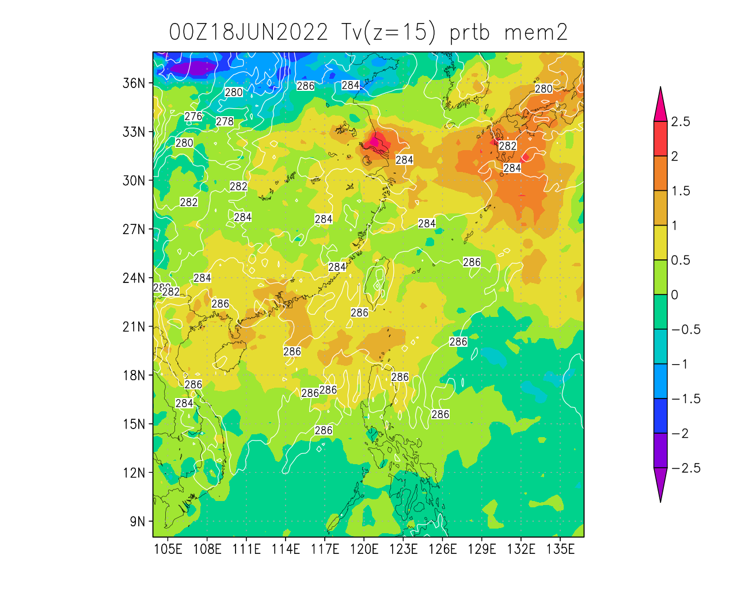
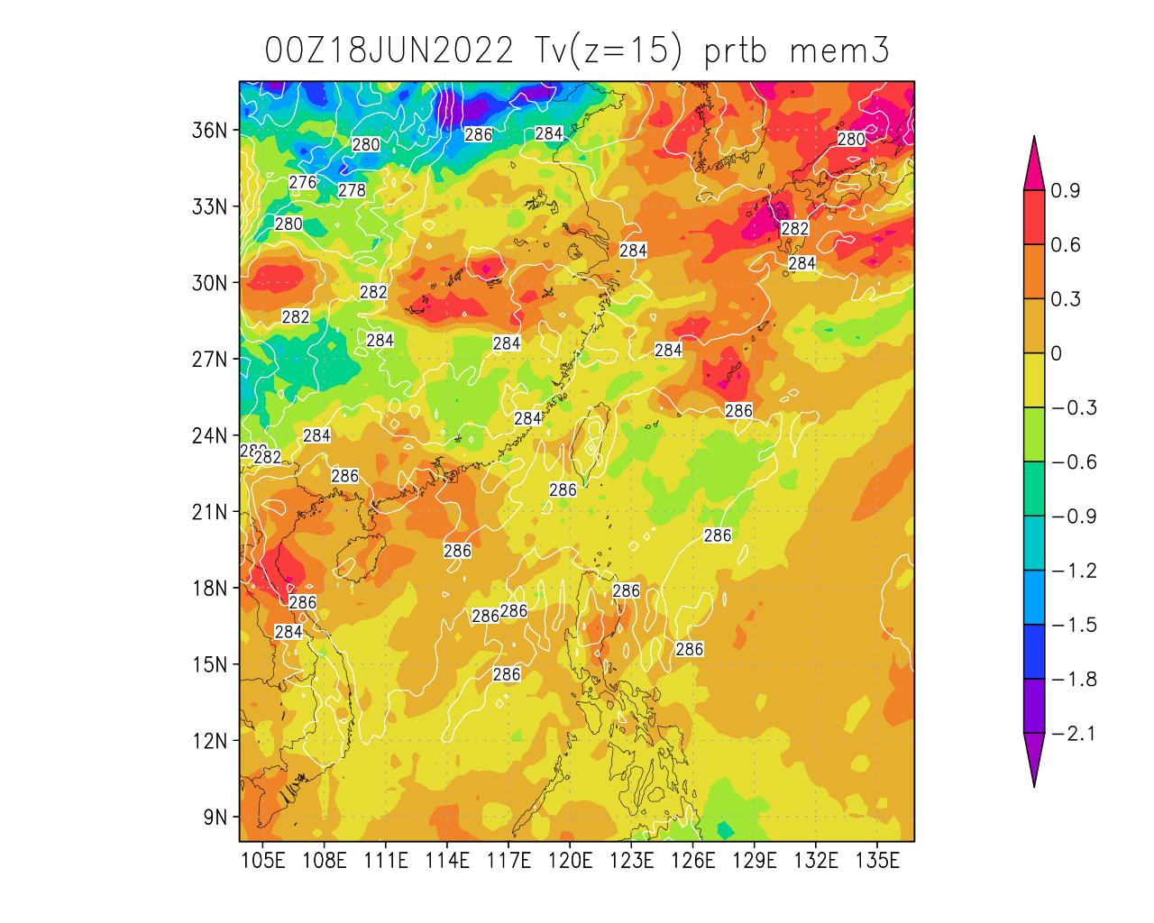
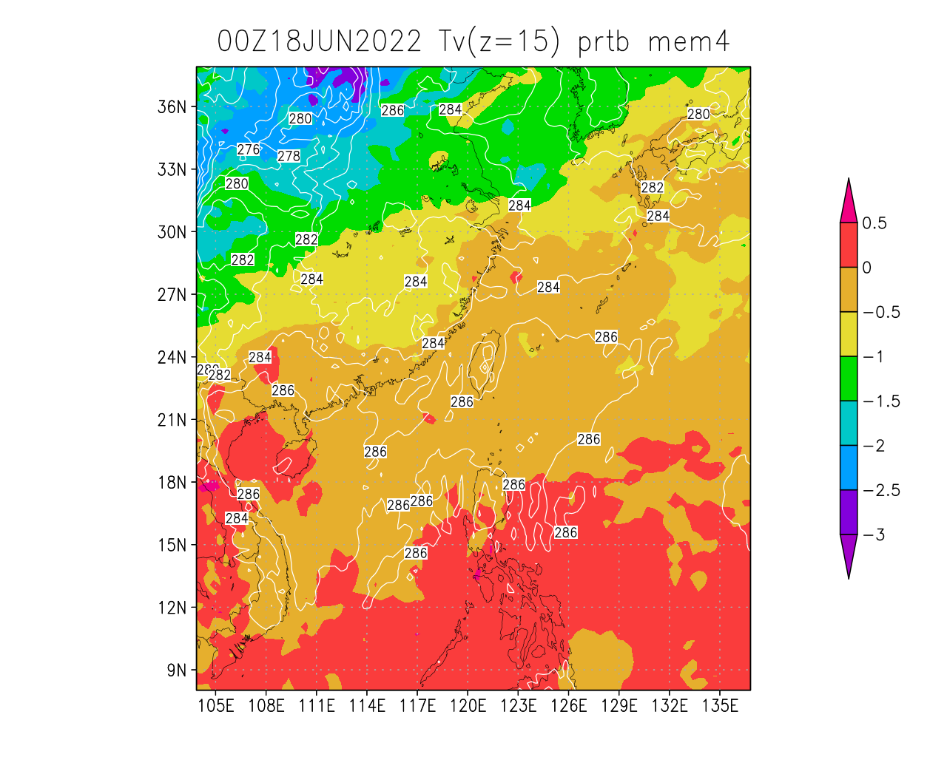
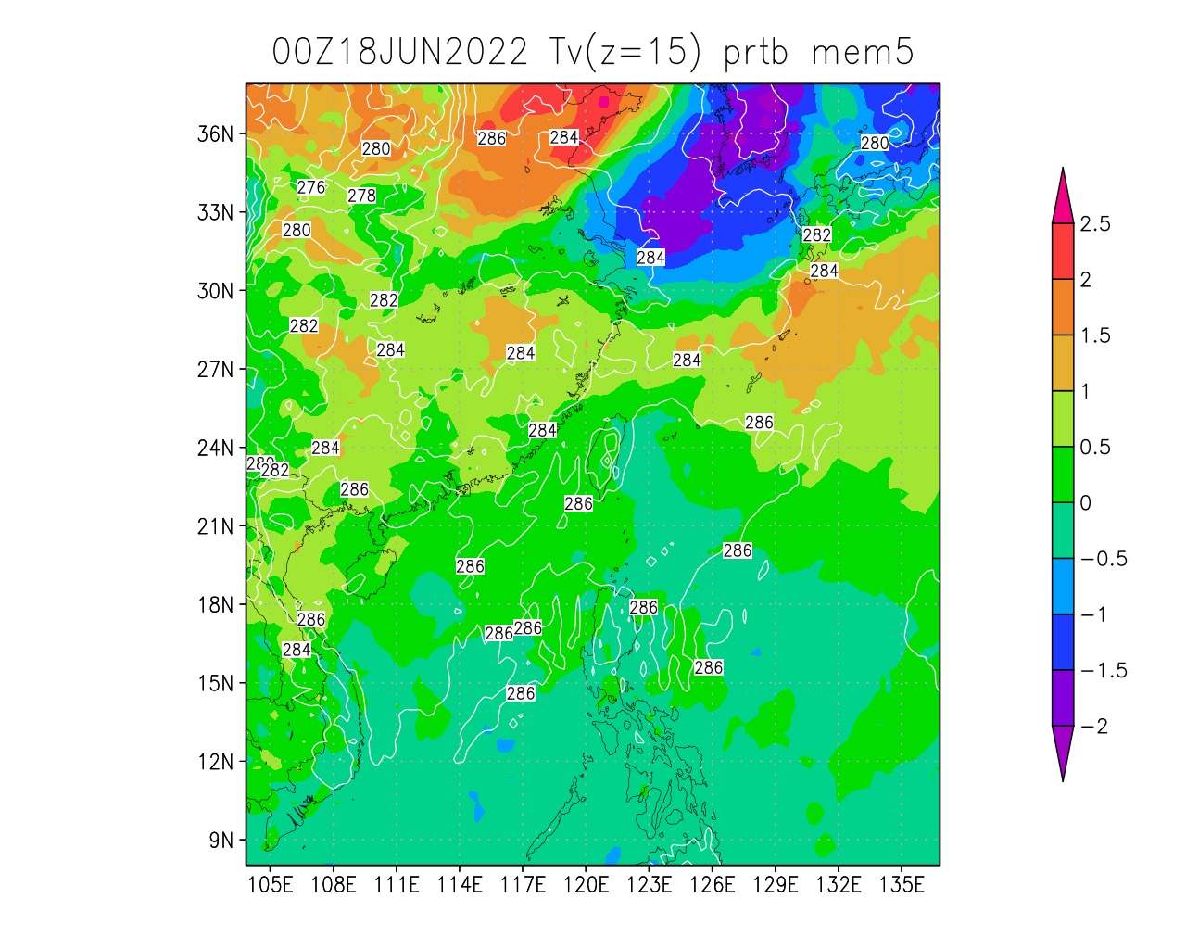
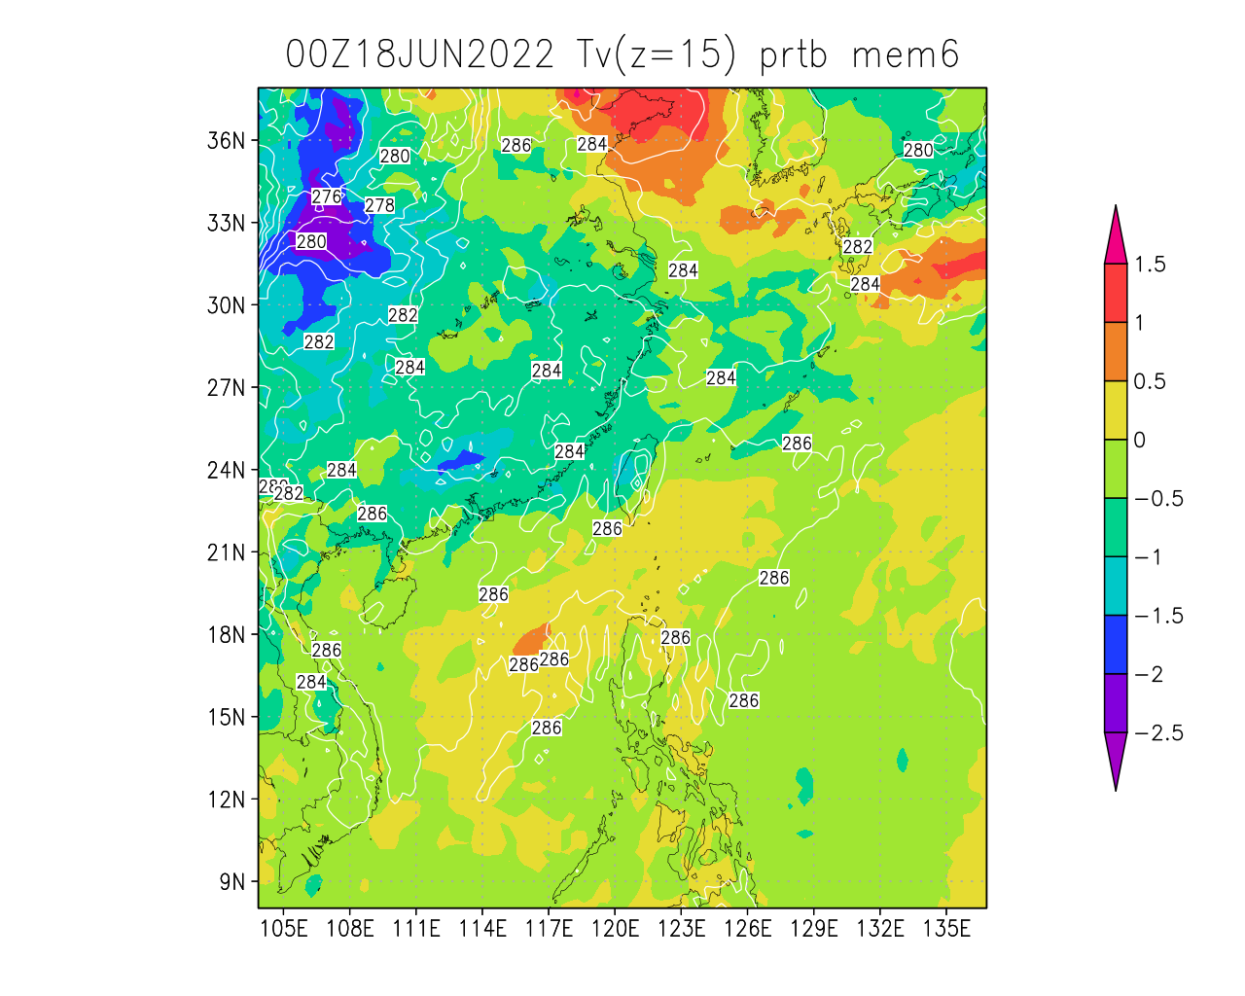
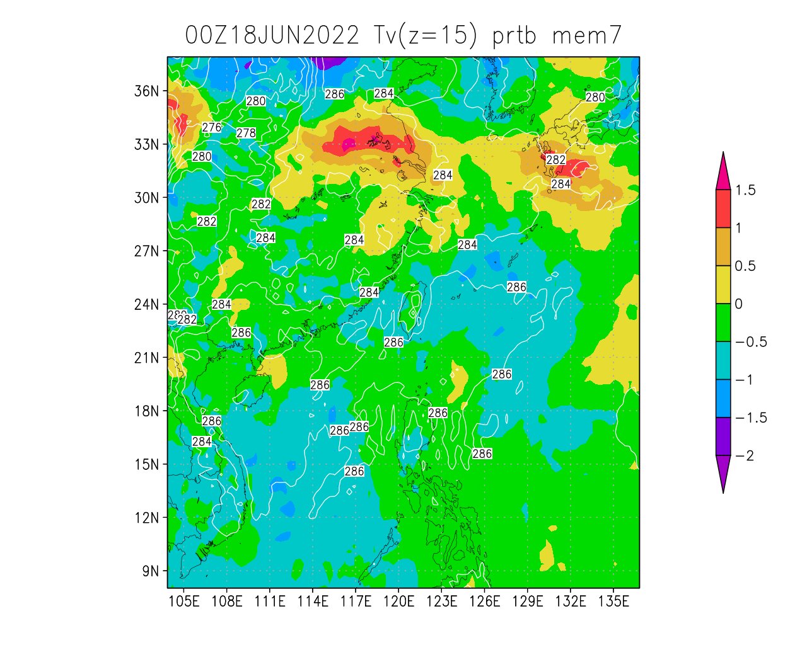
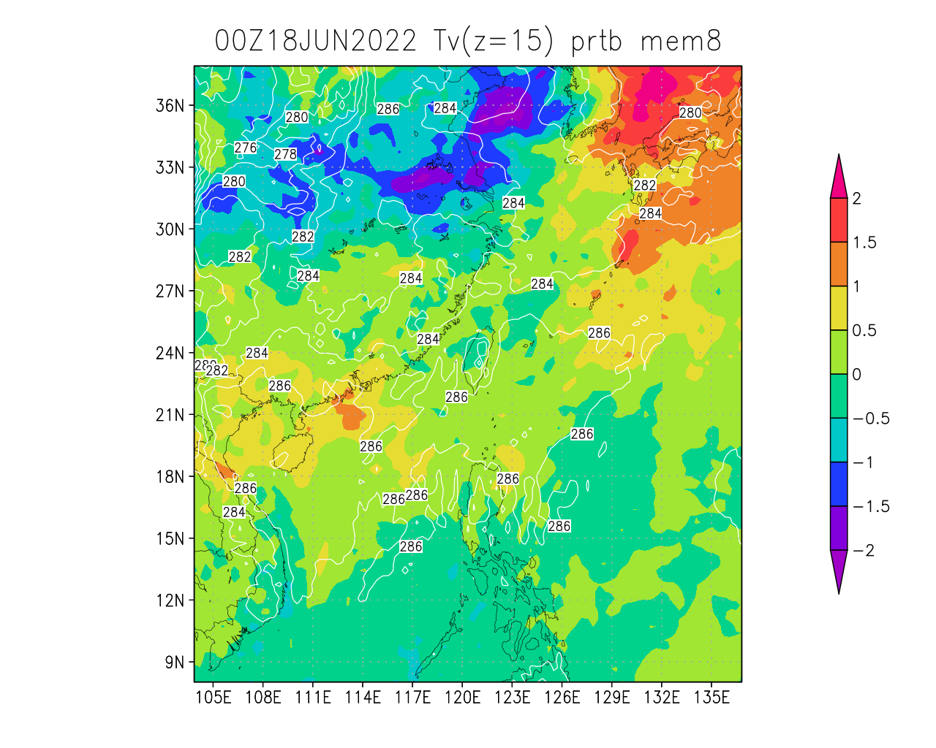
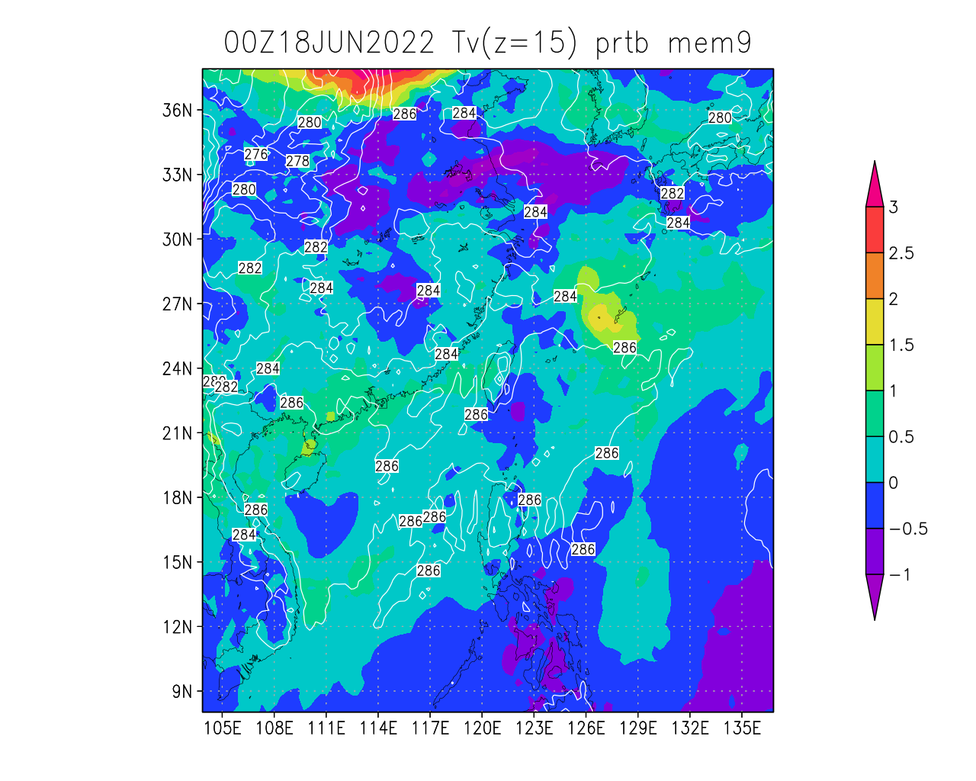
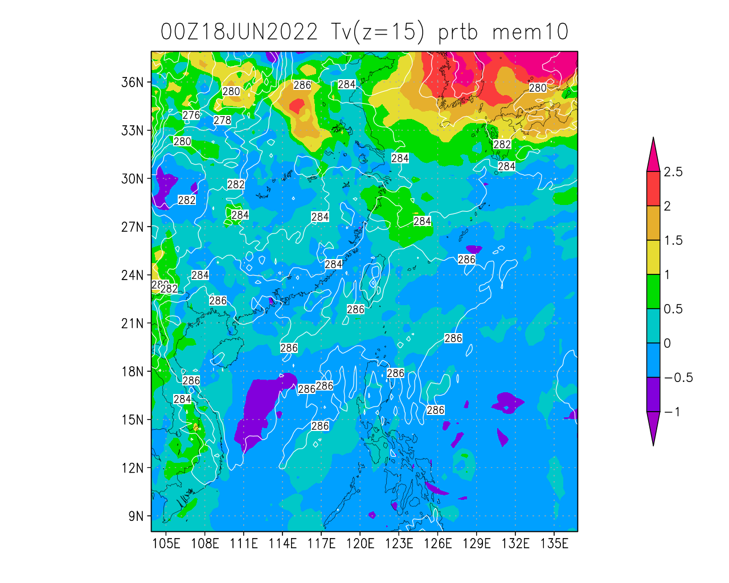
test Tv perturbations at z=15 (cycle=1)
Notes:
These perturbed members can be generated by ./run_addprtb.sh 1

Slide 7
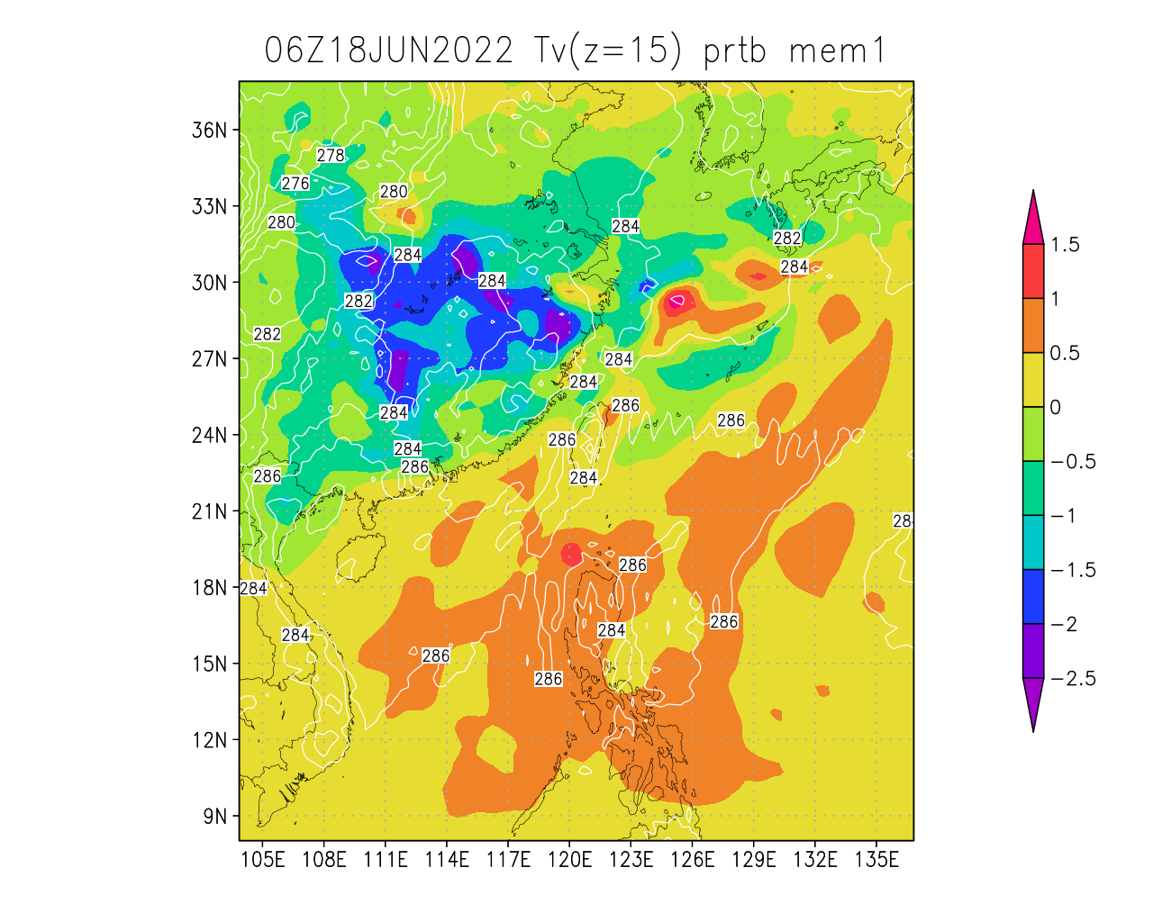
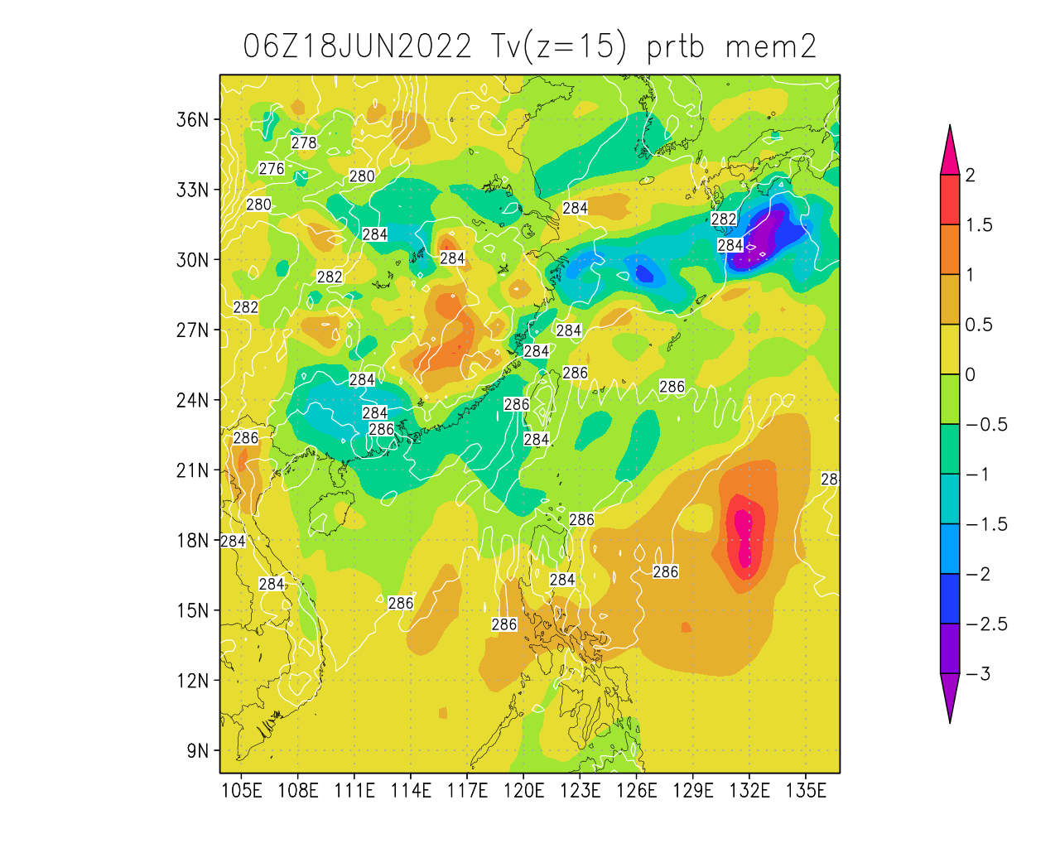
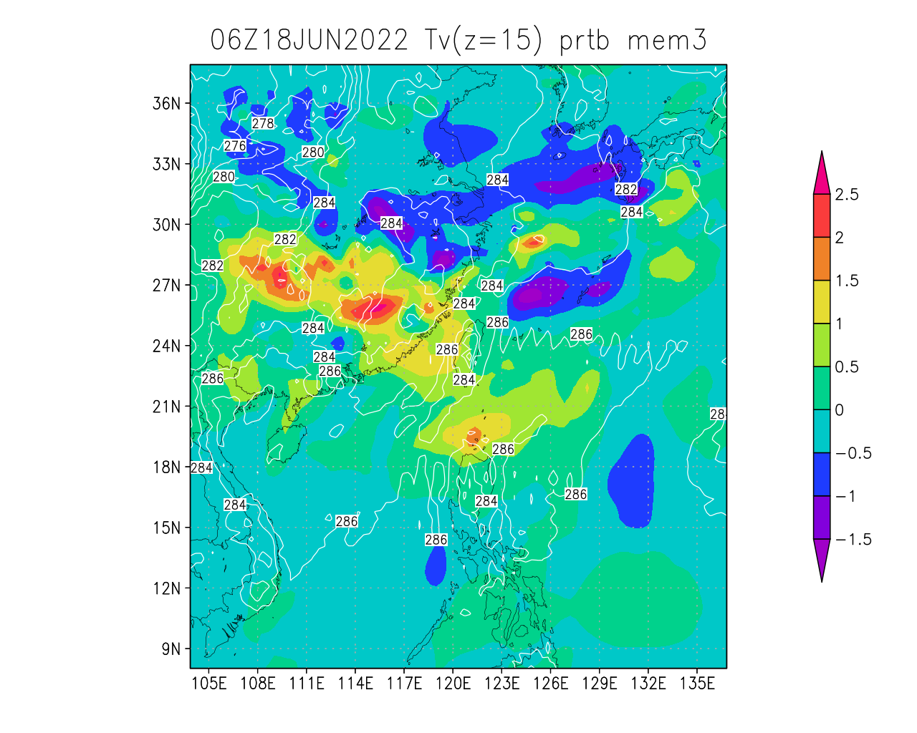
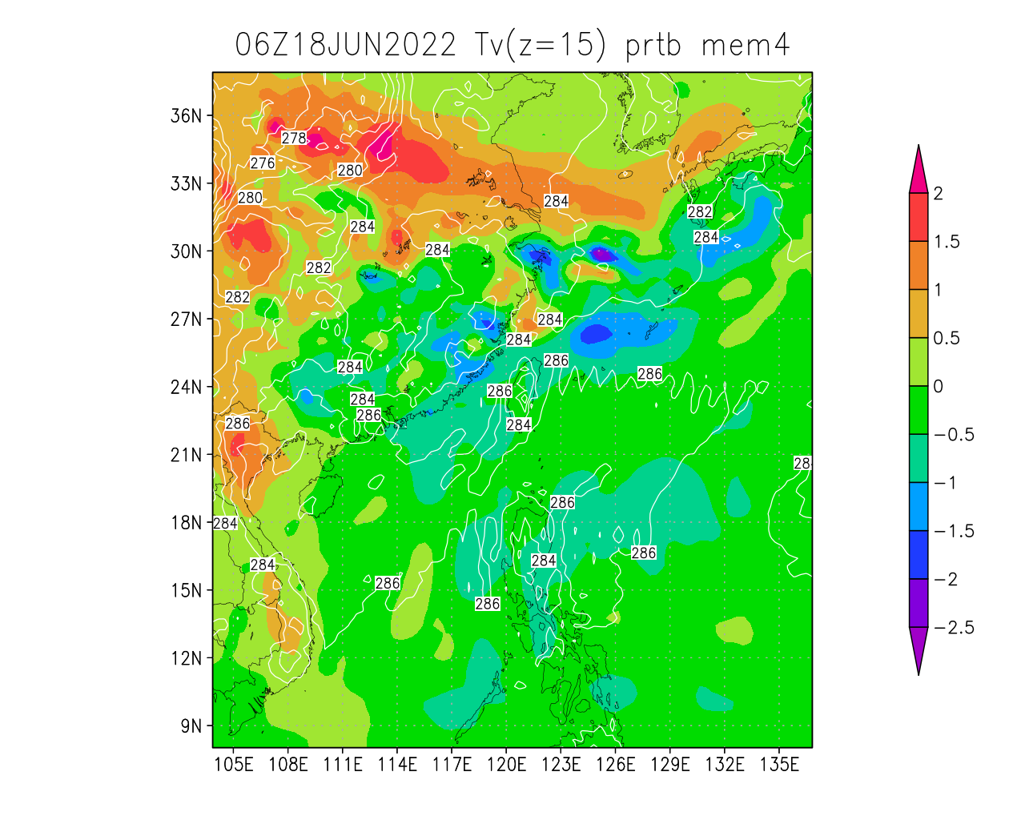
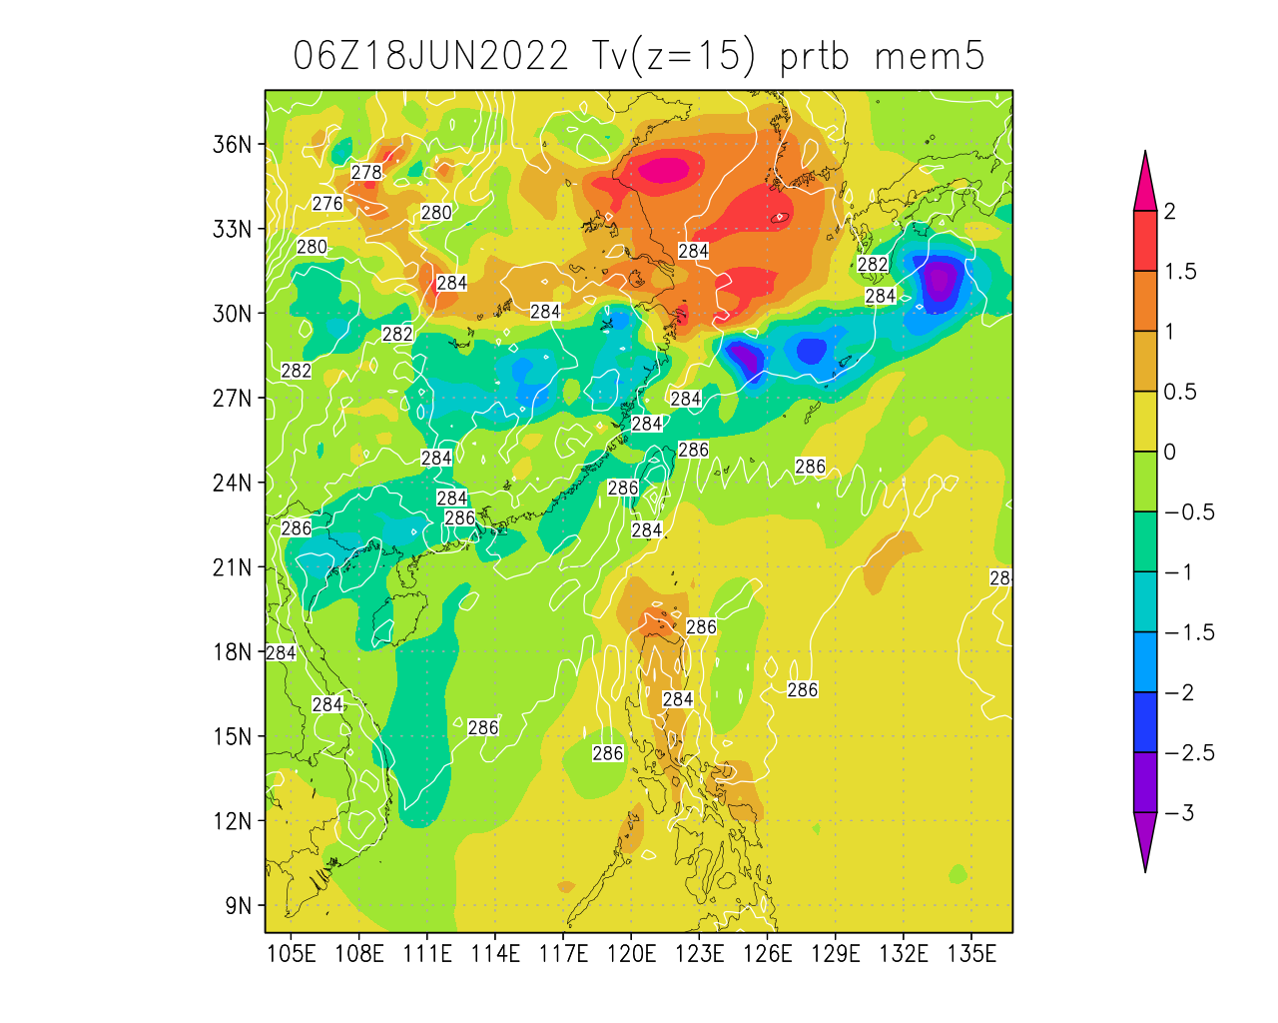
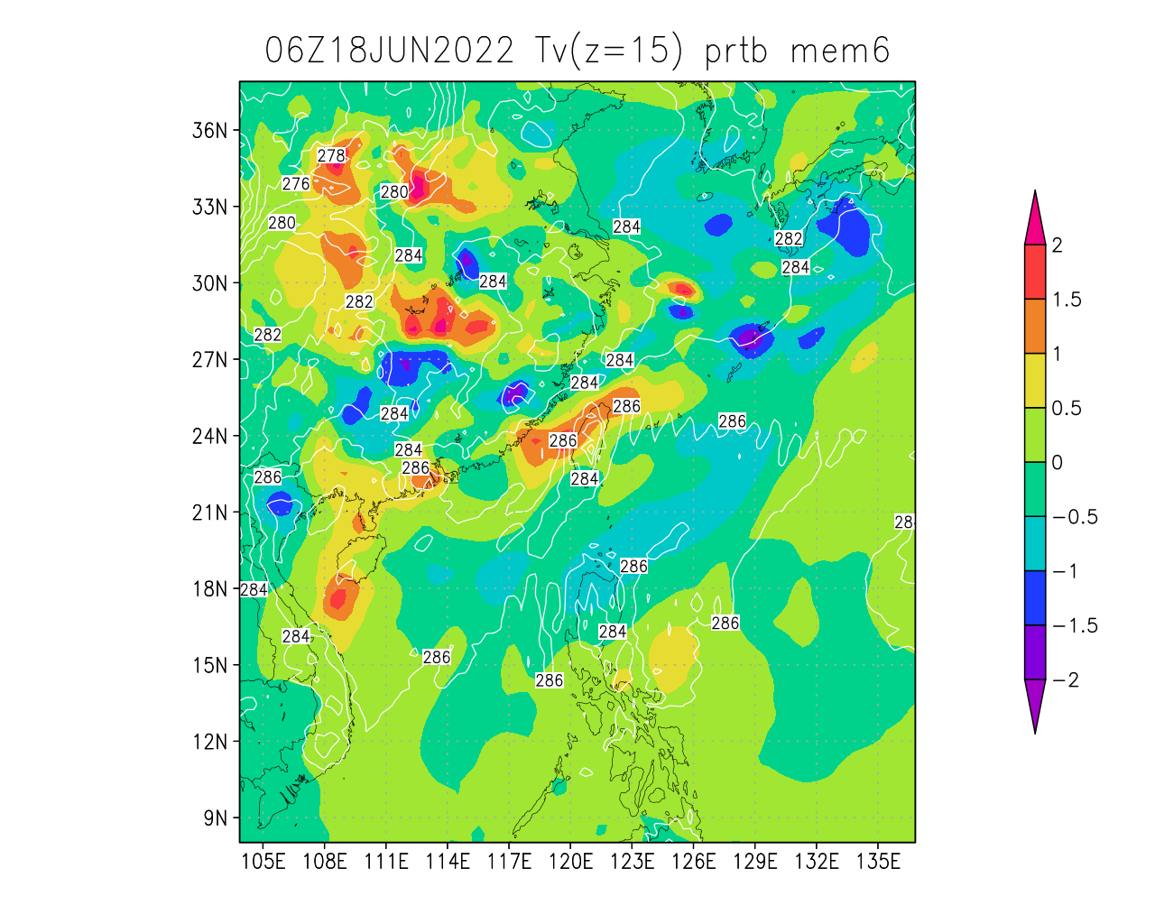
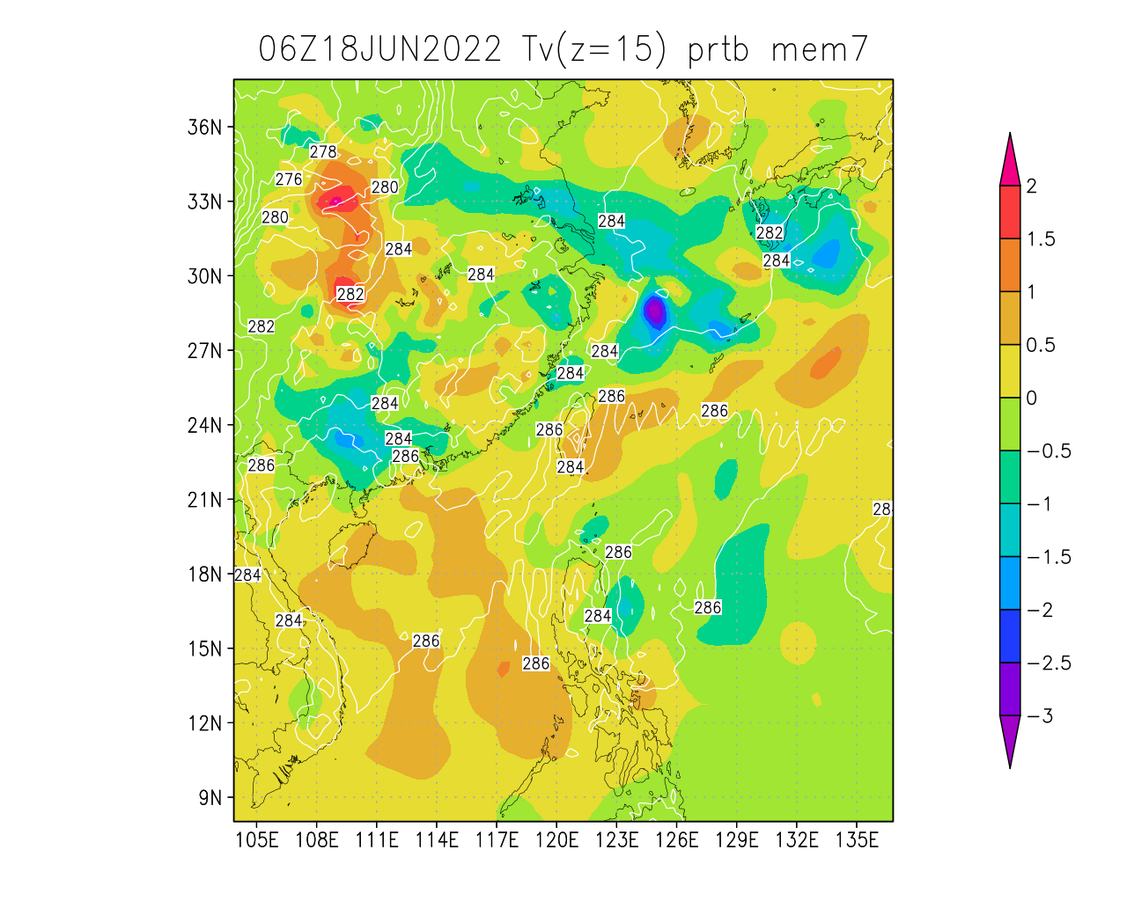
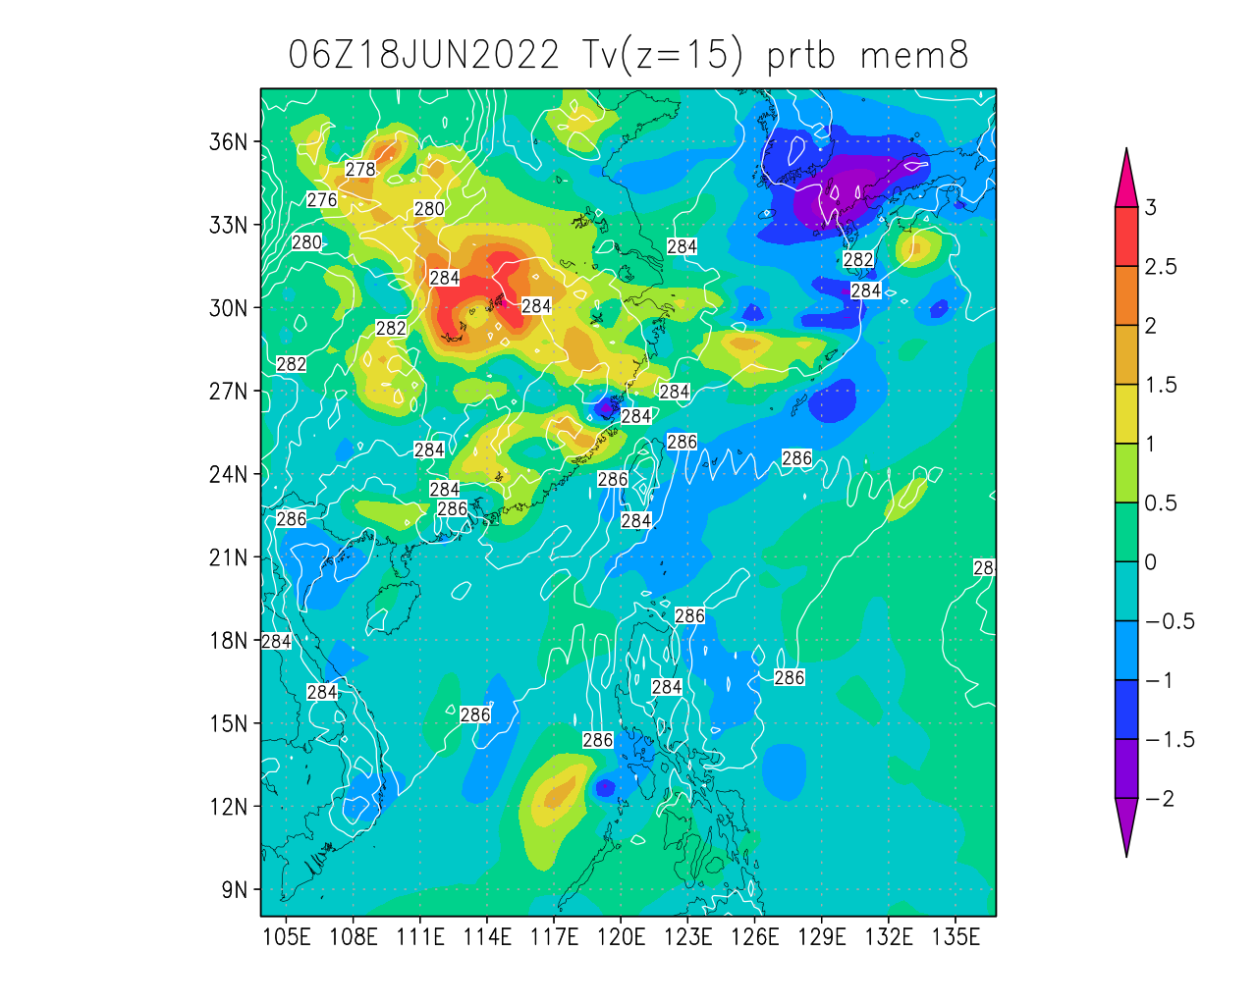
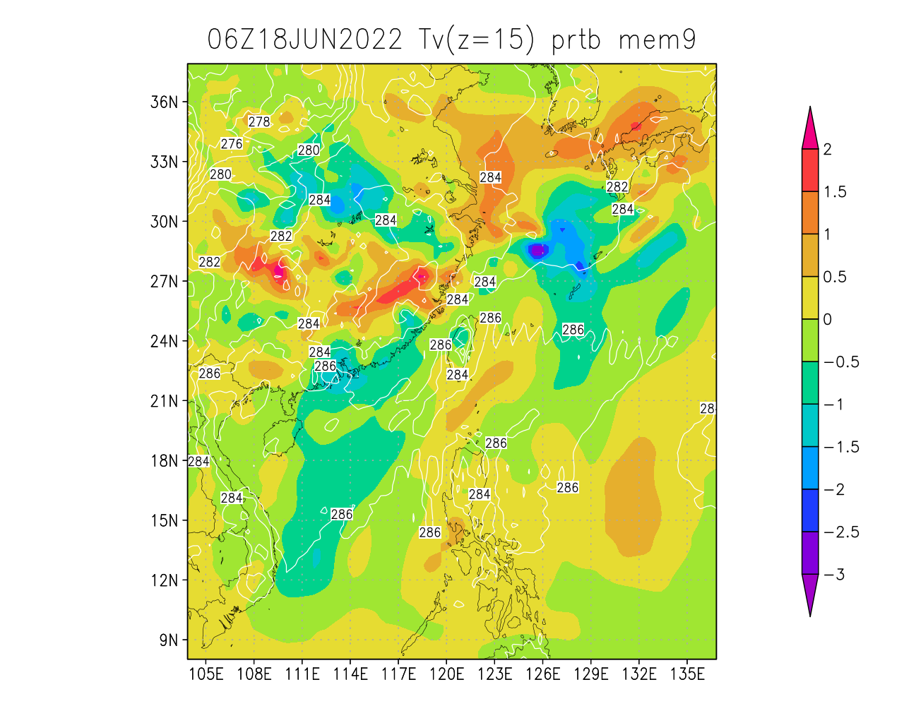
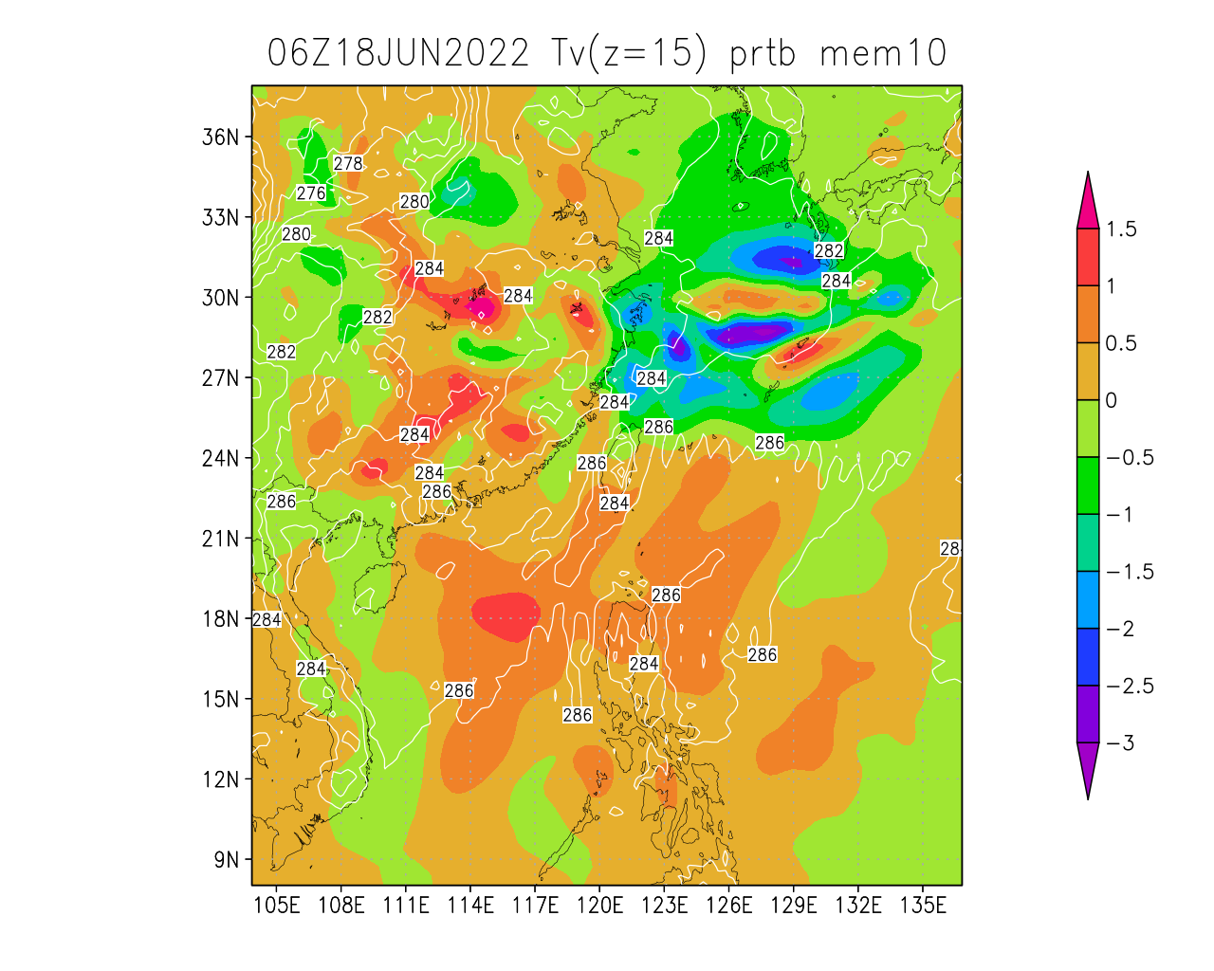
test Tv perturbations at z=15 (cycle=2)
Notes:
These perturbed members can be generated by ./run_addprtb.sh 2

